Slide 1
Project 1
TelcoGPT

Slide 2
Background & Problem
Telecom operators work with rapid-evolving, highly specialised knowledge: 3GPP standards, OSS/BSS alarms, RF design rules, field-troubleshooting play-books and more.
Much of this know-how lives in ageing wikis, scattered PDFs or “ask-an-expert” chat channels. The result is longer mean-time-to-repair (MTTR), duplicated design effort and slow onboarding of new engineers.

Slide 3
Impact
Impact area | Current pain | Consequence if unanswered
MTTR | Engineers spend minutes—or hours—searching or waiting for experts | SLA breaches, churn
Network evolution projects | Designers re-interpret specs independently | Re-work, compliance risk
Workforce productivity | New hires need months to absorb “tribal” knowledge | Extended onboarding cost
Customer support | First-line agents escalate simple issues | Higher OPEX

Slide 4
How stakeholders are handling this today?
Many engineers have begun using public LLM tools such as ChatGPT to fill knowledge gaps.
While helpful, those tools lack built-in telecom context, so users must prepend every query with ad-hoc primers:
“Assume I’m a mobile-core engineer working on a VoLTE rollout in a 5G SA network … also assume our vendor uses Release-17 protocols … now, what is 3GPP?”
Writing these primers is slow, brittle and risks leaking sensitive information.
Managers therefore want a standardised, enterprise-controlled interface where the telecom context is pre-seeded—allowing staff to ask concise questions (“What is 3GPP Release-17 SA2?”) and get immediate, on-point answers without exposing proprietary details.

Slide 5
Expanded Problem Statement & Business Requirements
Static knowledge bases decay – content owners cannot curate at the pace standards evolve.
Expert queues create latency – field teams wait while senior SMEs answer repetitive questions.
Context is fragmented – good answers must blend standards, live network state and prior conversation.
Ad-hoc use of public LLMs is risky – potential data leakage, inconsistent answers, no audit trail.
Any MVP must stay light-weight – complex RAG or fine-tuning pipelines add cost and governance burden in phase 1.

Slide 6
Exploring Solutions
Option | Strengths | Weaknesses | Decision
Refresh internal wiki | Low tech | Still manual, still search-heavy | Rejected
Enterprise search (BM25 / Elastic) | Familiar tooling | No reasoning, unstructured answers | Rejected
RAG on vector DB | Accuracy, grounding | Needs embedding pipeline & data-governance | Deferred to phase 2
Prompt-engineered assistant | Fast to market, no new infra, leverages GPT-4o reasoning | Relies on prompt quality | Chosen for MVP

Slide 7
GenAI Architecture Pattern: Prompt based solutions
Use Case: Prompt Based QnA Engine for Telecom
Context | Telecom engineers and support teams need instant, domain‑accurate answers (standards, alarms, design rules) without wading through ageing wikis or specialist‑only Slack threads.
Problem | Static knowledge bases become outdated; “ask‑an‑expert” queues delay troubleshooting and design decisions. A light‑weight solution—without external vector databases or RAG—is required to serve authoritative, consistently‑formatted responses.
Solution

Slide 8
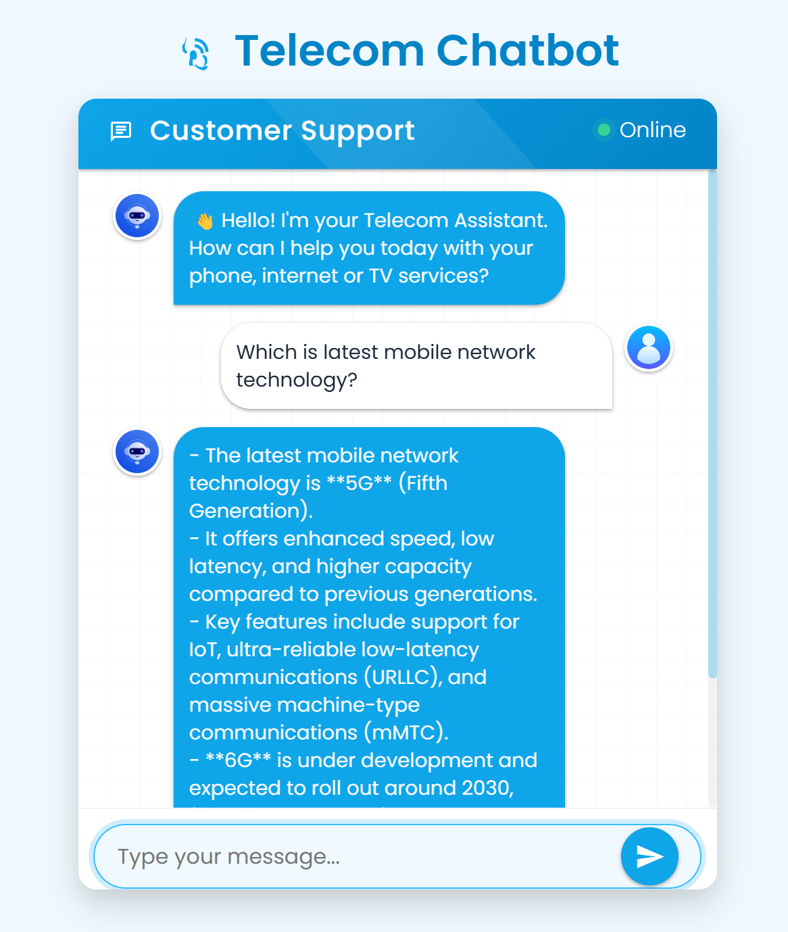
GenAI Architecture Pattern: Prompt based solutions
Use Case: Prompt Based QnA Engine for Telecom
Context | Telecom engineers and support teams need instant, domain‑accurate answers (standards, alarms, design rules) without wading through ageing wikis or specialist‑only Slack threads.
Problem | Static knowledge bases become outdated; “ask‑an‑expert” queues delay troubleshooting and design decisions. A light‑weight solution—without external vector databases or RAG—is required to serve authoritative, consistently‑formatted responses.
Solution | TelcoGPT Assistant: a prompt‑engineered GPT‑4o instance on Azure OpenAI. Queries are routed into three Telco Cards (Definition, Troubleshooting, Design‑Recommendation). A Python Flask backend assembles the correct system prompt, enforces response format, maintains chat history, and serves a minimal web UI. Deployed on an Azure VM; secrets handled via Key Vault; metrics via App Insights.

Slide 9
GenAI Architecture Pattern: Prompt based solutions
Use Case: Prompt Based QnA Engine for Telecom
User Browser (HTML Chat UI)
HTTPs/Chat
Prompt Based Backend
Query Router
Prompt Builder
Format Validator
Conversation Store (Redis)
- Rest API
Azure SDK
Azure OpenAI (Gpt-4o)
App Insights (logs)
Azure Key Vault

Slide 10
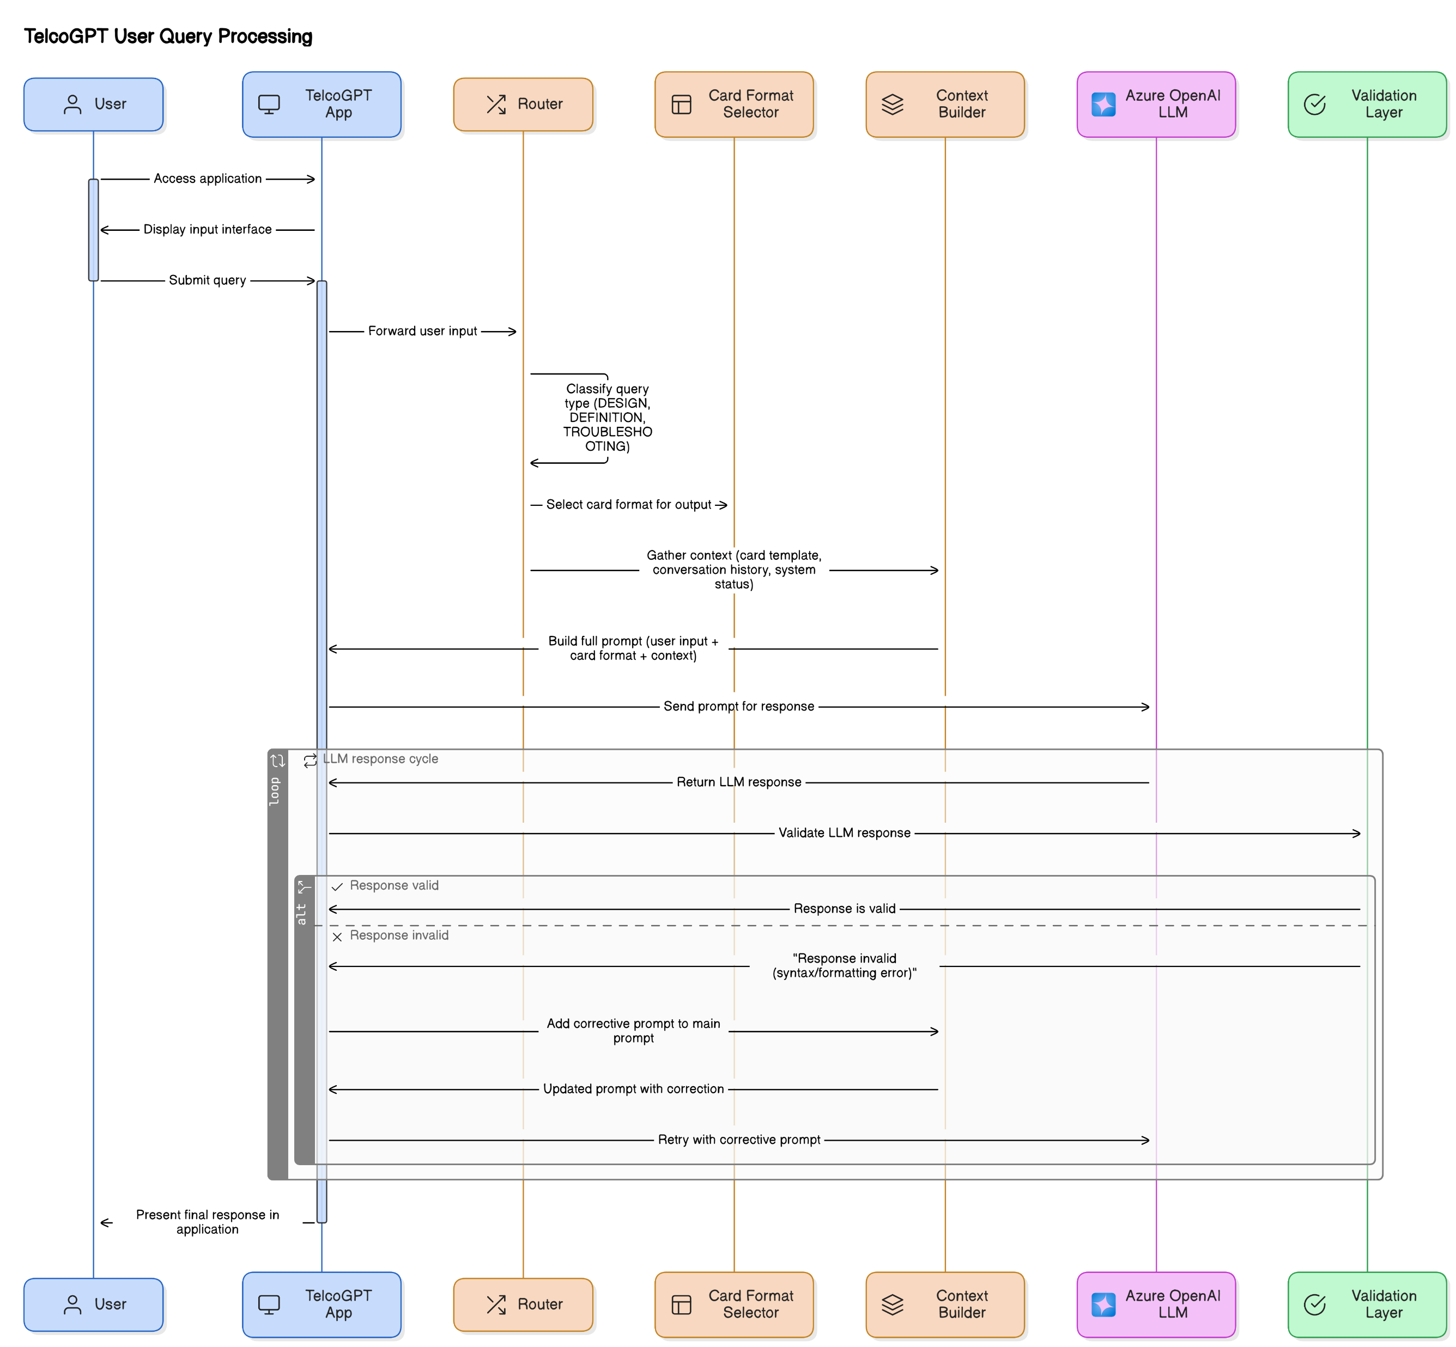

Slide 11
